Slide 1

Python!
Day 1

Slide 2
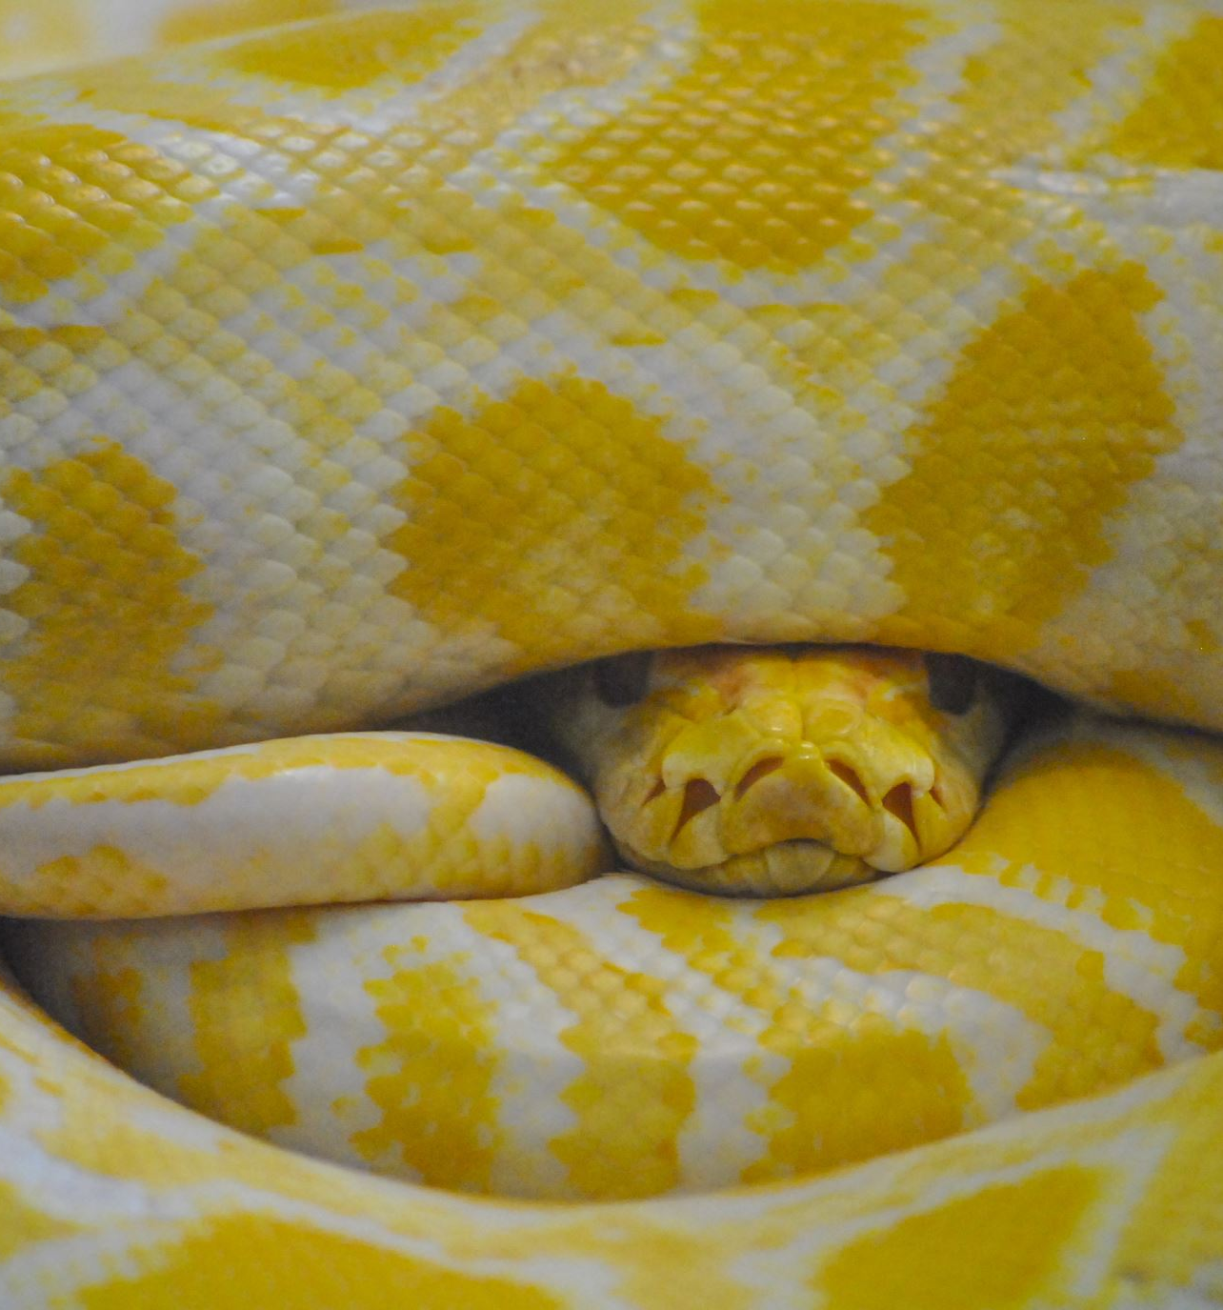
Welcome to learning to code in Python!
What is Python?
Python is a popular programming language used in professional and hobbyist programs
What is Python used for?
Python is used to make a whole bunch of programs – everything from robots and machines to video games and AI
Python is the most programming language used to make AI like ChatGPT

Slide 3

How to run python
When we write code, we write it using words humans understand
Like print(“Good morning”) causes the program to print good morning
But computers need code to be “translated” into instructions they can understand
Online compilers like Visual Studio Code and Pycharm make it easy for code to be translated, allowing the programs we create to run with the click of a button

Slide 4
How to download PyCharm
Google “Download PyCharm”
Download the community python installer
Open the installer and follow the instructions on the screen
Open PyCharm
Press “New Project” and click “Create”

Slide 5
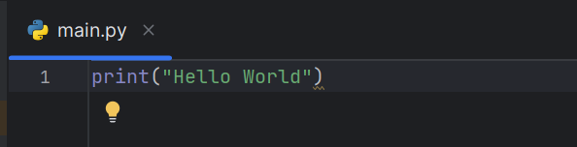
The First Program
In your new python file on the first line write:
print(“Hello World”)

Slide 6
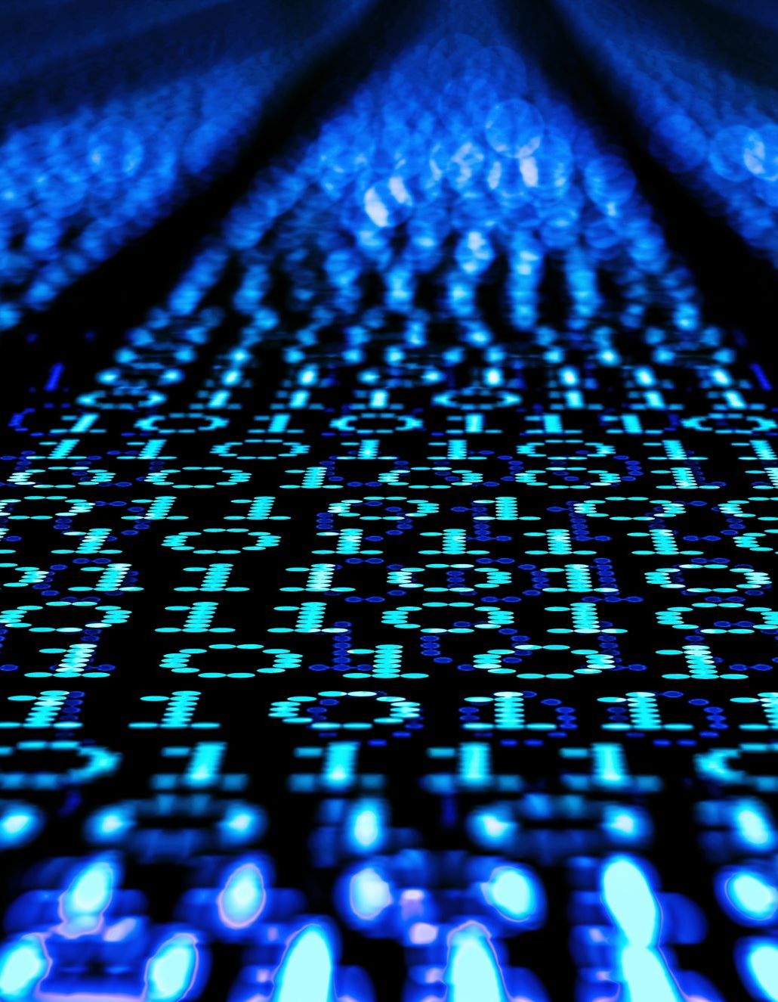
How Computers Work
When we write print(“Hello World”) and run our program, this is translated into binary – the language computers understand made up of 1s and 0s
Computers aren’t very smart – a computer can only translate and understand code if it’s written in a very specific way. It’s up to the programmers to make sure the computer can understand them
For example: If you misspell print(“Hello World”) as prinnt(“Hello World”), then the computer will get confused
Try typing in prinnt(“Hello World”) in python and see what happens

Slide 7
Printing to the Screen
We can print to the screen using the print() function
When we print something, we must put the words we want to print in quotes
Otherwise, the computer gets confused, and we get an error
Try writing print(Hello World) in python and see what happens
The print() function prints exactly what is in the quotes
Try printing a grocery list with the print() function
Hint: Try writing a new print command for every item on the list

Slide 8
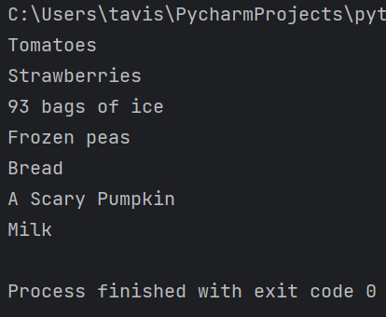
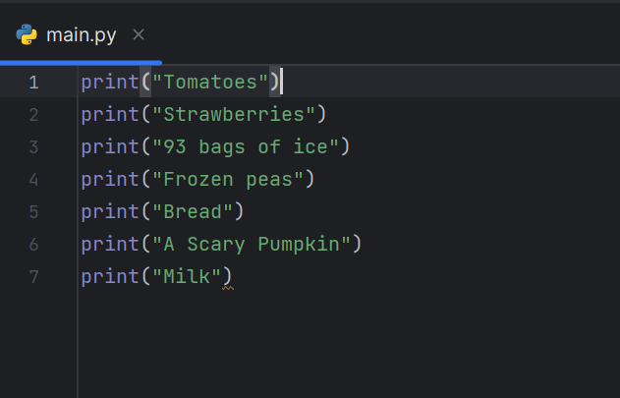

Slide 9
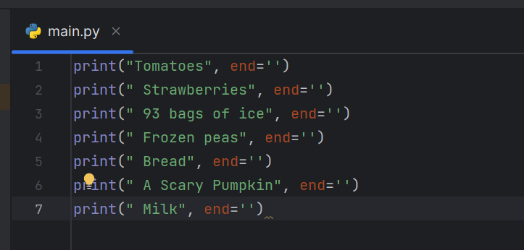
Printing on the Same Line
In the previous example we printed out a grocery list, notice how all of the items appeared on separate lines? What if we want them to be on the same line?
To do this we use this syntax: print(“hello world”, end = ‘ ‘)

Slide 10
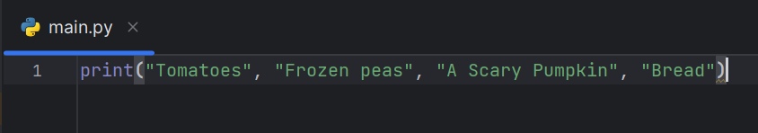
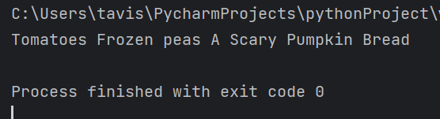
We can also just use one print statement and say:
print(‘Apple’, ‘banananna’, ‘oranges’)
Just separate the words with commas.

Slide 11
First Project: Printing a Story
Practice using the print() function to write a story about a boy named Raymond
Maybe Raymond gets lost in the woods or is on a search for treasure
Make it short, no more than 10 lines but at least 3 lines long
Use Raymond’s name at least 3 times

Slide 12
Variables
Now let’s say that we want to change the name of our character from Raymond to Stewart. Rewriting the code with Stewart would take a lot of time and effort. Our story is short, but what if it was hundreds of lines long? What do we do?
We use what is called a variable.
A variable is like a box or a container that holds information
When we want to use that information, we just take it out of the box

Slide 13
Declaring Varibles
To create a variable, we give the variable a name. This is label on the box
Let’s call our variable name
To create a variable called name we type:
name = “Raymond”
This is like taking the value “Raymond” and placing it into a box called name
When we want to use “Raymond” we just say name instead of using “Raymond”
This makes code clean, and we can change what name equals once instead of hundreds of times.

Slide 14
When are Variables Used?
Variables can be used to make things simpler and easier to read code that can’t be read is useless.
We use variables when we don’t know what value to use. What if the player in a game wants to input their own name? Are you going to write a separate program for every possible name? (Just use a variable since it can take any value)
We use variables when using something over and over again

Slide 15
Printing Variables
Variables don’t need to be surrounded by “ ” to be printed, try writing:
name = “Raymond”
print(name)
When our variables contain words, we can mix them with normal text and print it
But we must use + to join variables and words
print(“Good morning, “ + name)

Slide 16
Writing a Story – with Variables
Now we can change our story so we can use a variable for Raymond’s name
Change print(“One day, Raymond went to the forest”)
to print(“One day, “ + name + “ went to the forest”)
Now change Raymond’s name to Stewart
name = “Stewart”
Now we can change the name of the story’s main character whenever we want

Slide 17
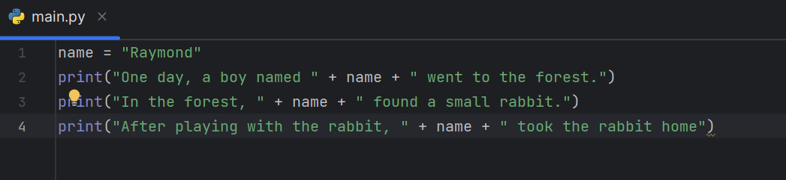
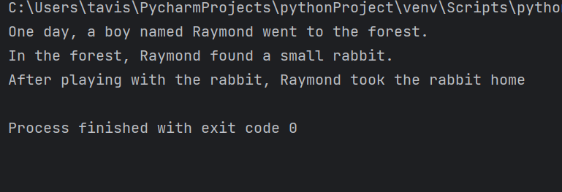
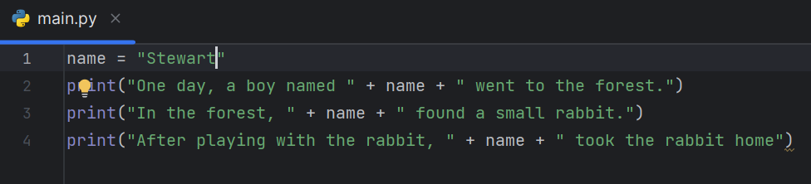
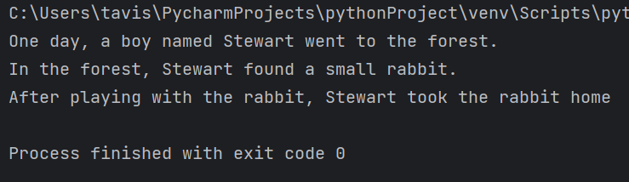

Slide 18
Reassigning Variables
What happens if you run this code? Try it out
name = “Raymond”
print(name)
name = “Stewart”
print(name)
What happens here is that the value inside the variable is replaced.
It’s like taking an item out of our box with the label “name” and replacing it with a different item
This is known as reassigning a variable

Slide 19
Input
What if we wanted our story to use the user’s name instead of a name we create?
For that we can use the input() function
If we write:
name = input(“What is your name? “)
then the program will ask the user “What is your name? “ and wait for the user to type their name. Then, the name variable will equal whatever the user types
Try it out

Slide 20
Writing a story – with User Input
Replace the line where we write
name = “Stewart”
With
name = input(“What is your name? “)
Now we have a program that writes a story personalized to the user

Slide 21
